Slide 1
Sloping Triangle

Slide 2
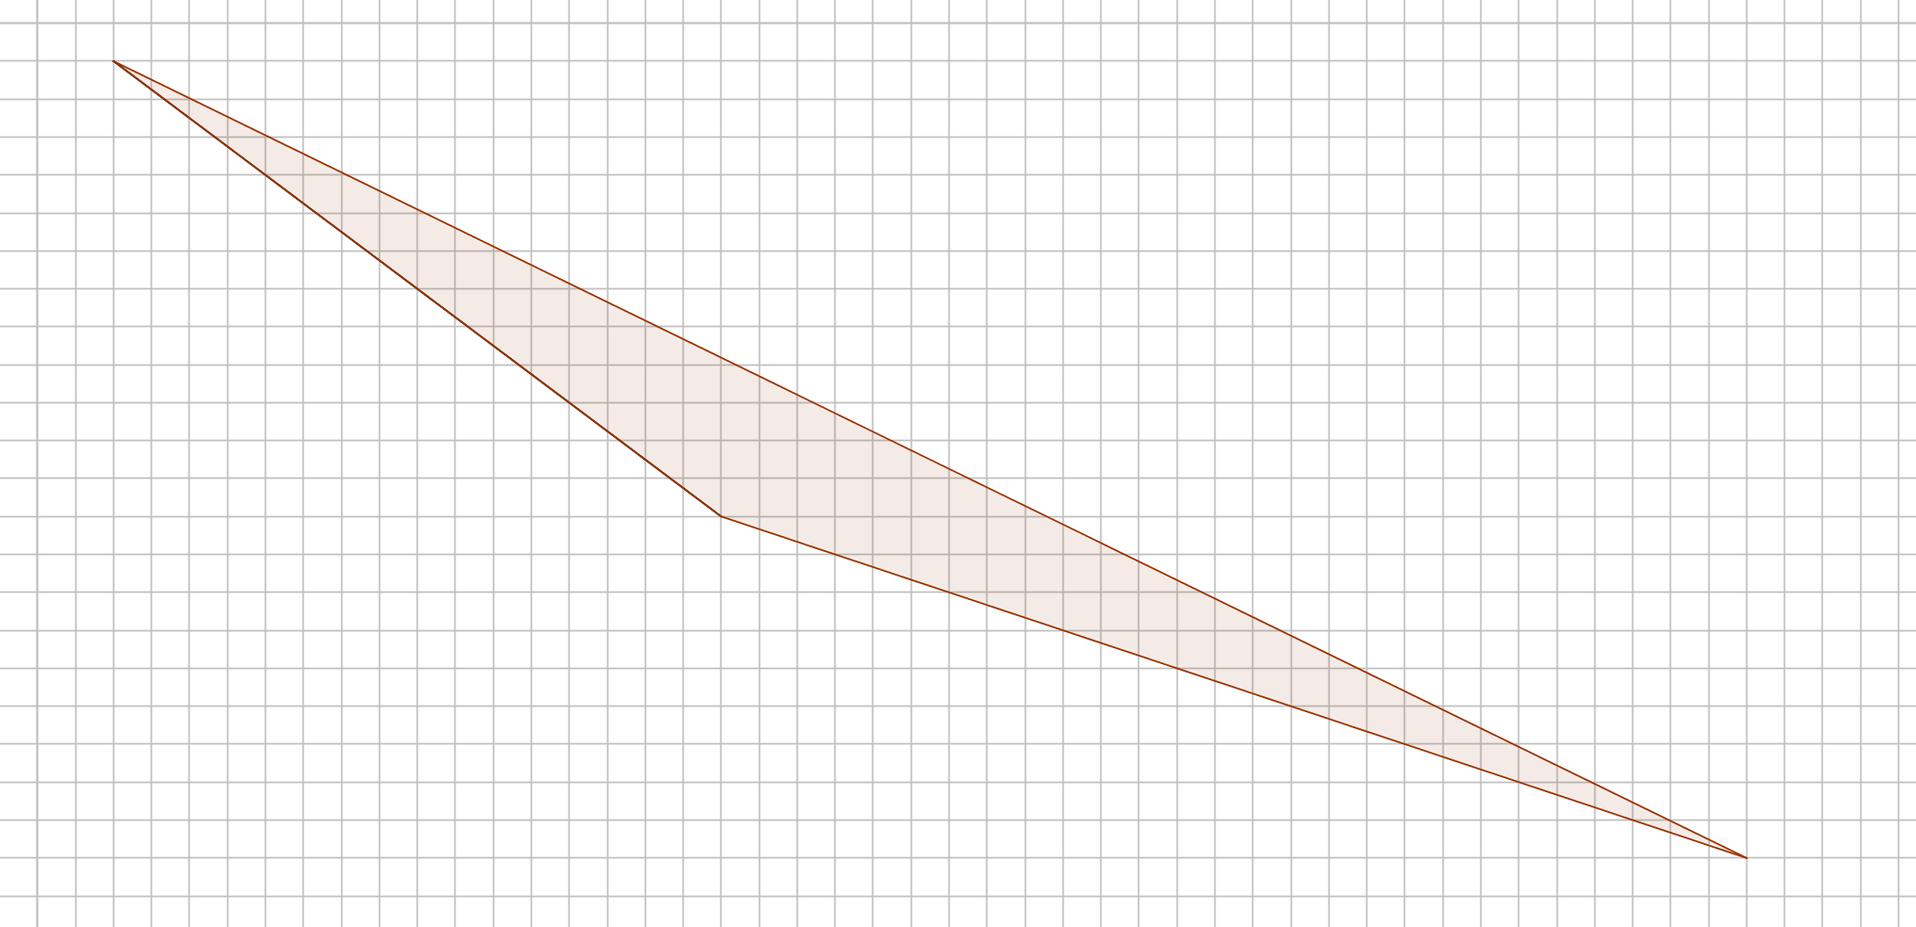
Sloping Triangle
What’s the area of this triangle?
(Each square represents 1 cm²)

Slide 3










Sloping Triangle
$\frac{1}{2}×21×43−(96+144+121.5)$
$451.5−361.5$
$90$
Here’s one method.
$$12$$
$$96$$
$$16$$
$$21$$
$$9$$
$$144$$
$$121.5$$
$$27$$
$$43$$

Slide 4

Sloping Triangle
$\frac{1}{2}×21×43−(96+144+121.5)$
$451.5−361.5$
$90$
Area is $90$ cm²
Can you think of another way using just one area calculation?

Slide 5



Sloping Triangle
HINT: These triangles have the same area.
$$h$$
$$b$$
$$b$$

Slide 6
Sloping Triangle
The blue triangle has the same area.
Its base and height are the same.
Parallel lines

Slide 7



Sloping Triangle
This blue triangle has the same area as the previous blue triangle.
Its base and height are the same.
$$12$$
$$15$$
$\frac{1}{2}×12×15=90$

Slide 8





Sloping Triangle
$$\frac{1}{2}×20×h=90$$
$$h=9$$
$$12$$
$$20$$
$$90$$
$$16$$
What is the distance between these parallel lines ?

Slide 9

Sloping Triangle
$$\frac{1}{2}×20×h=90$$
$$h=9$$
The distance is 9 cm
What is the distance between these parallel lines ?

Slide 11
RESOURCES

Slide 12
Sloping Triangle
What’s the area of this triangle?
(Each square represents 1 cm²)
A
SIC_56

Slide 13
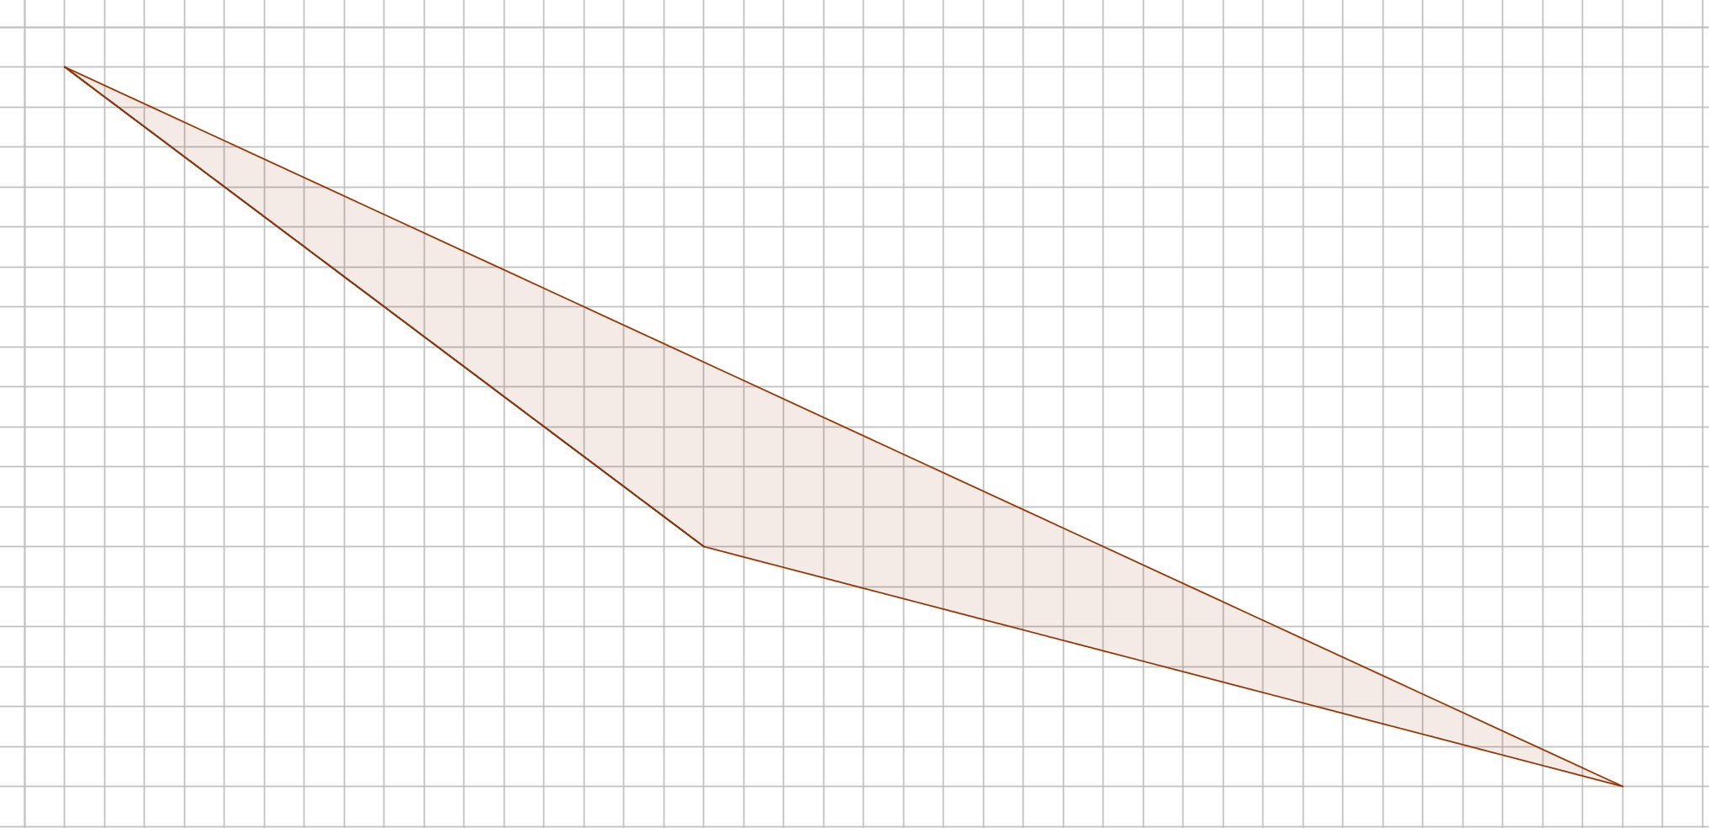
Sloping Triangle
What’s the area of this triangle?
(Each square represents 1 cm²)
B
SIC_56

Slide 14
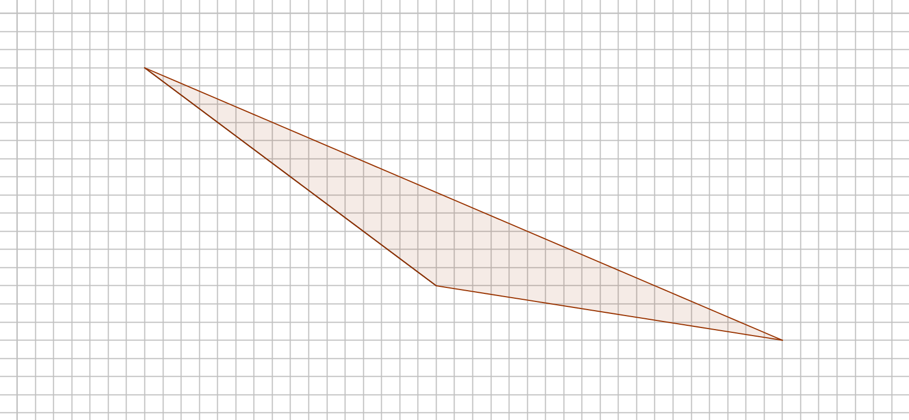
Sloping Triangle
What’s the area of this triangle?
(Each square represents 1 cm²)
C
SIC_56

Slide 15
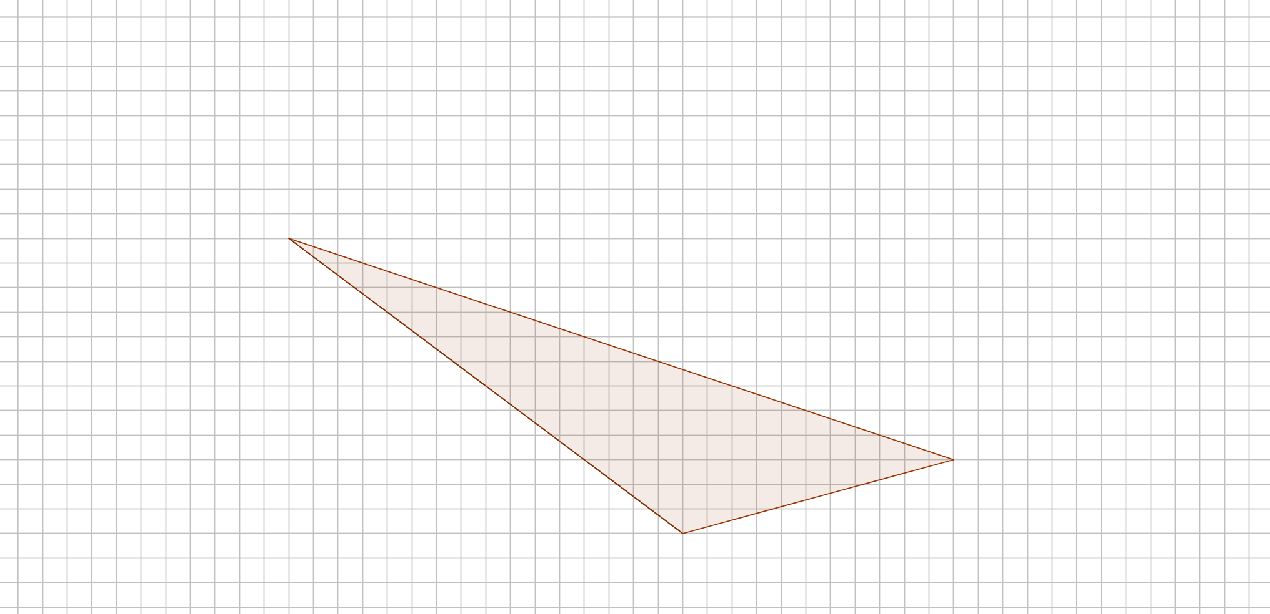
Sloping Triangle
What’s the area of this triangle?
(Each square represents 1 cm²)
D
SIC_56

Slide 16
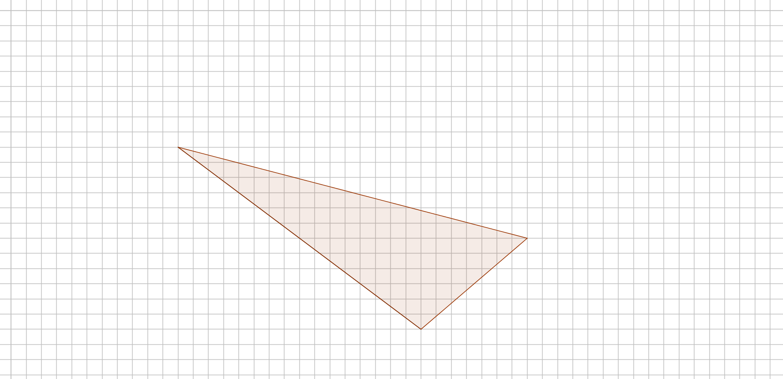
Sloping Triangle
What’s the area of this triangle?
(Each square represents 1 cm²)
E
SIC_56

Slide 17
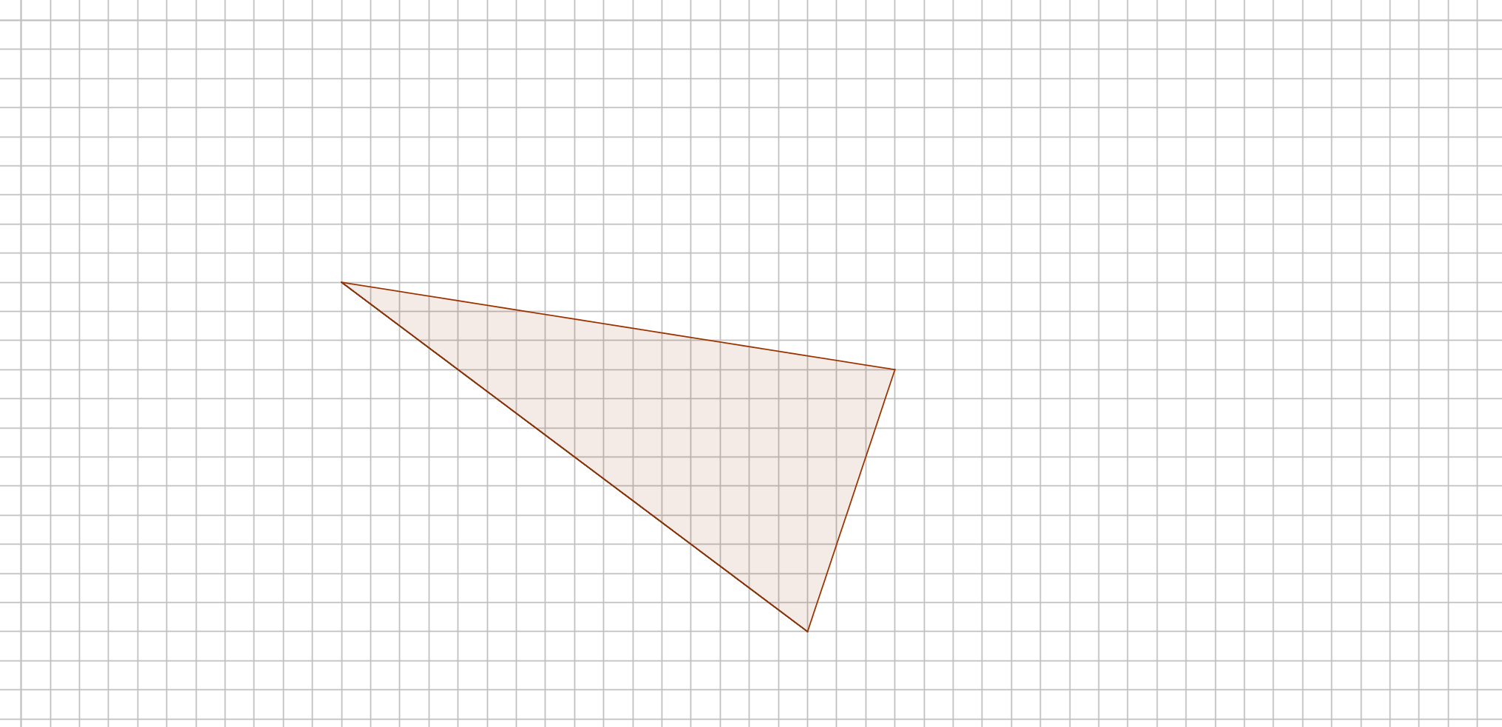
Sloping Triangle
What’s the area of this triangle?
(Each square represents 1 cm²)
F
SIC_56

Slide 18
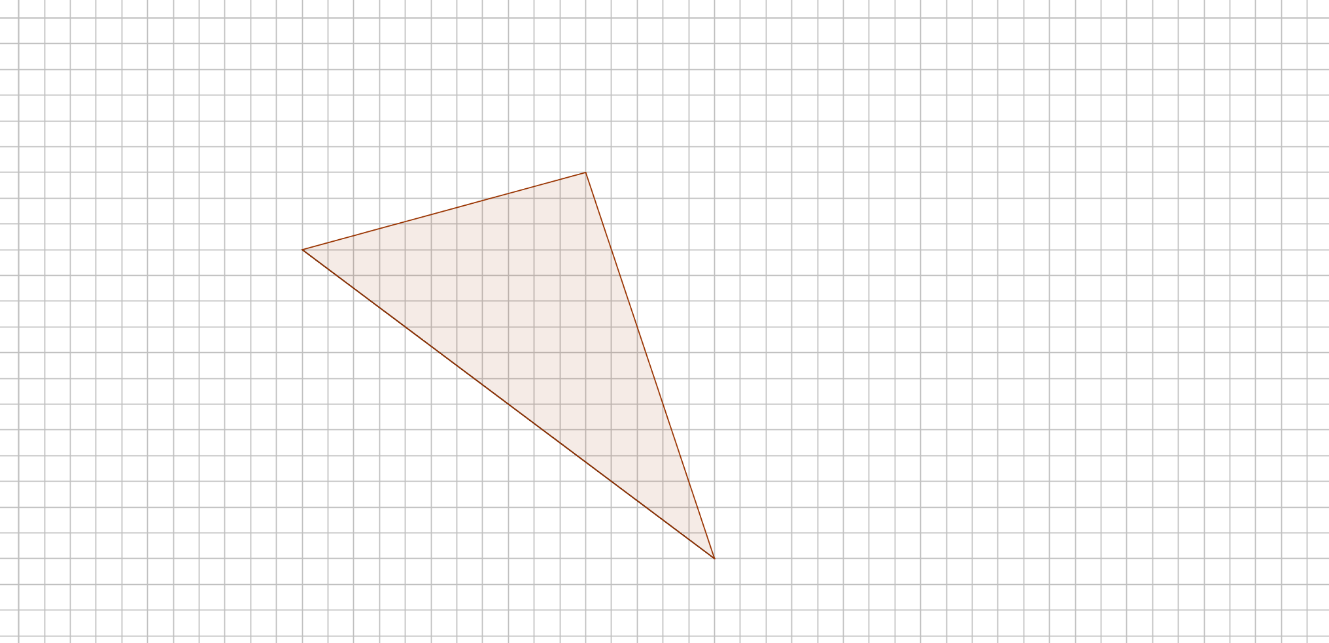
Sloping Triangle
What’s the area of this triangle?
(Each square represents 1 cm²)
G
SIC_56

Slide 19
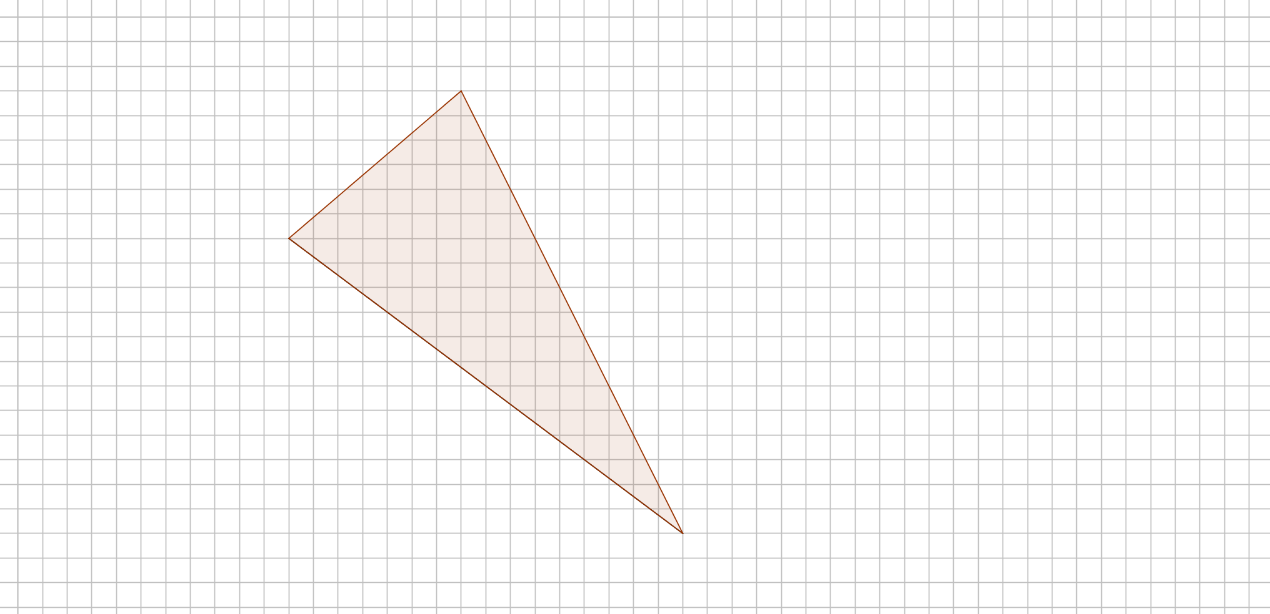
Sloping Triangle
What’s the area of this triangle?
(Each square represents 1 cm²)
H
SIC_56

Slide 20
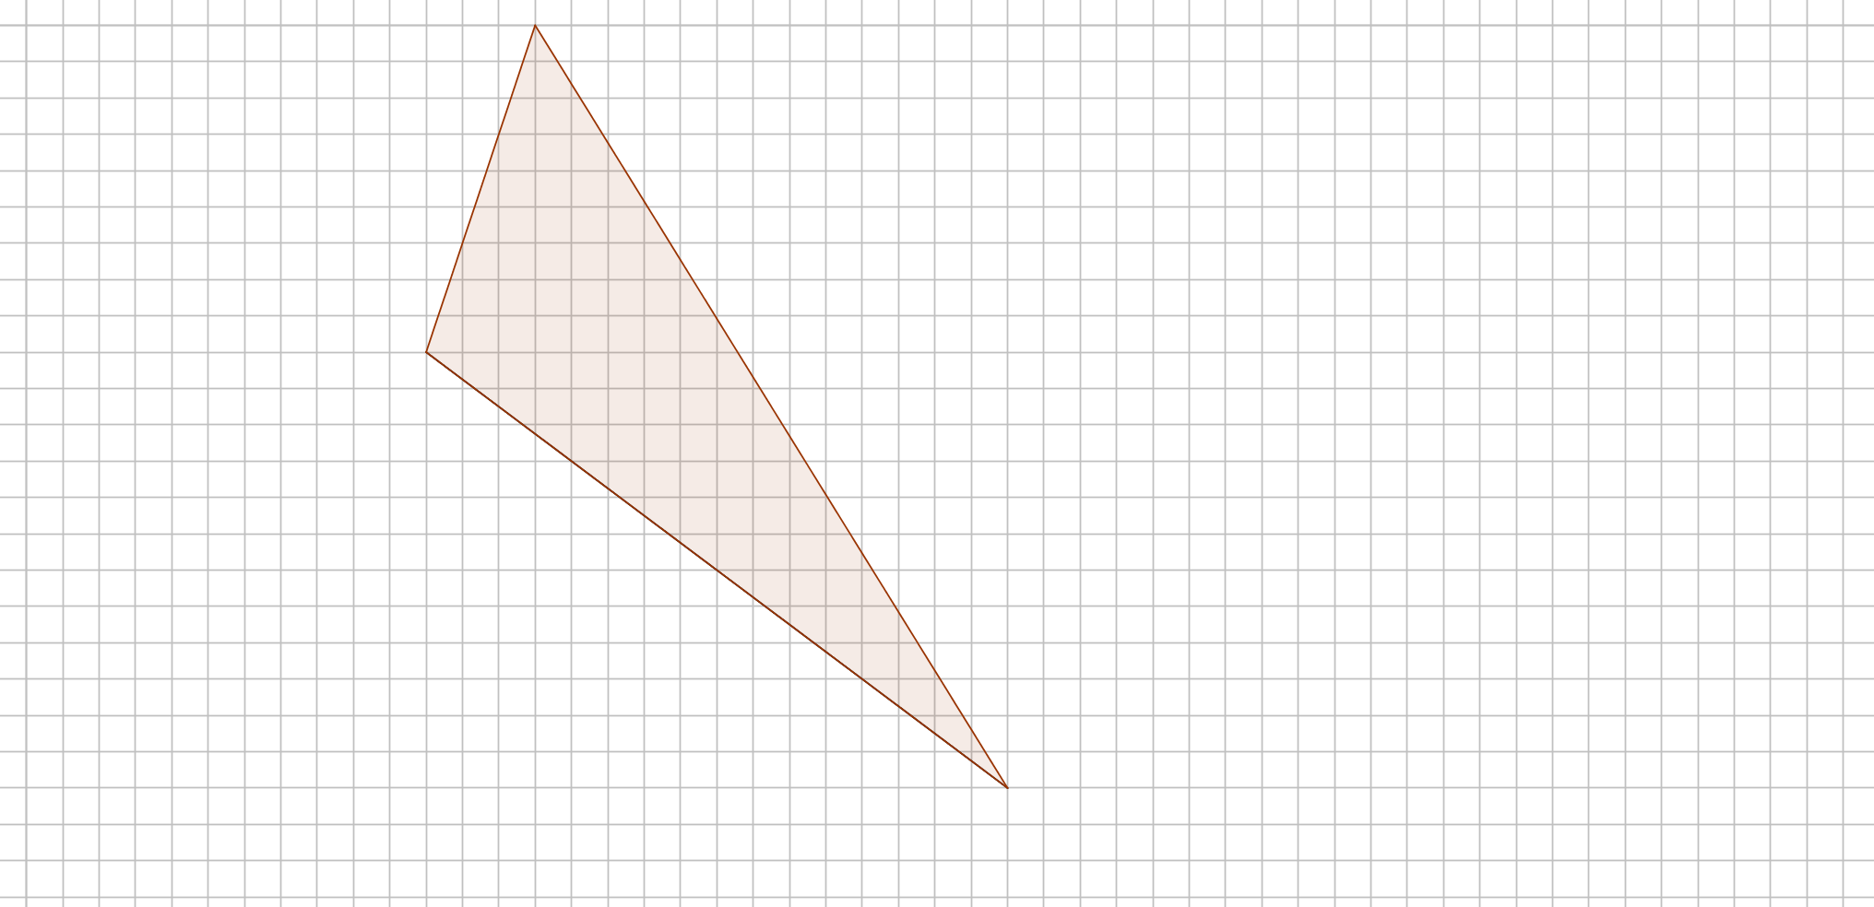
Sloping Triangle
What’s the area of this triangle?
(Each square represents 1 cm²)
I
SIC_56

Slide 21
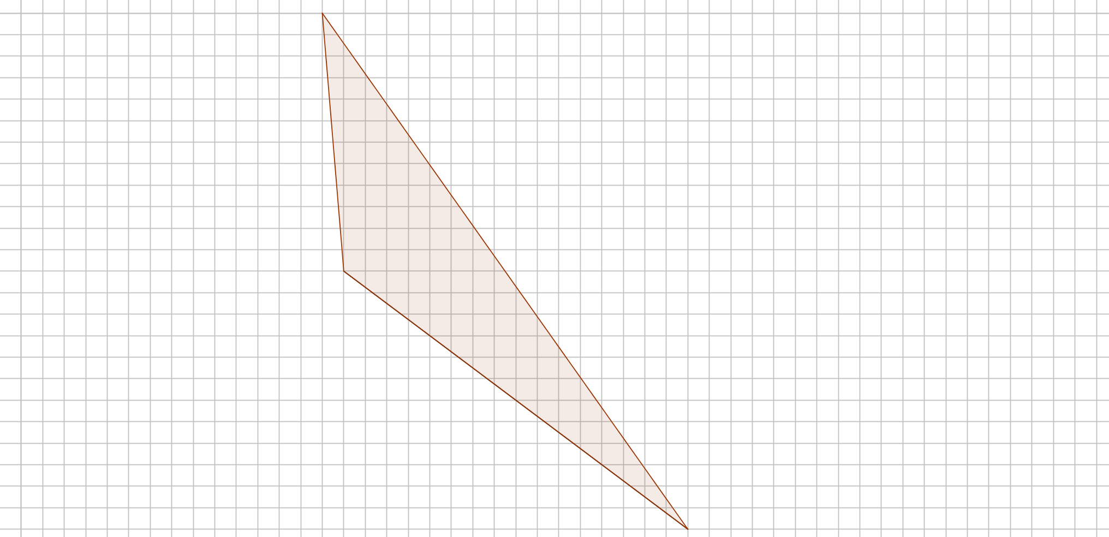
Sloping Triangle
What’s the area of this triangle?
(Each square represents 1 cm²)
J
SIC_56

Slide 22
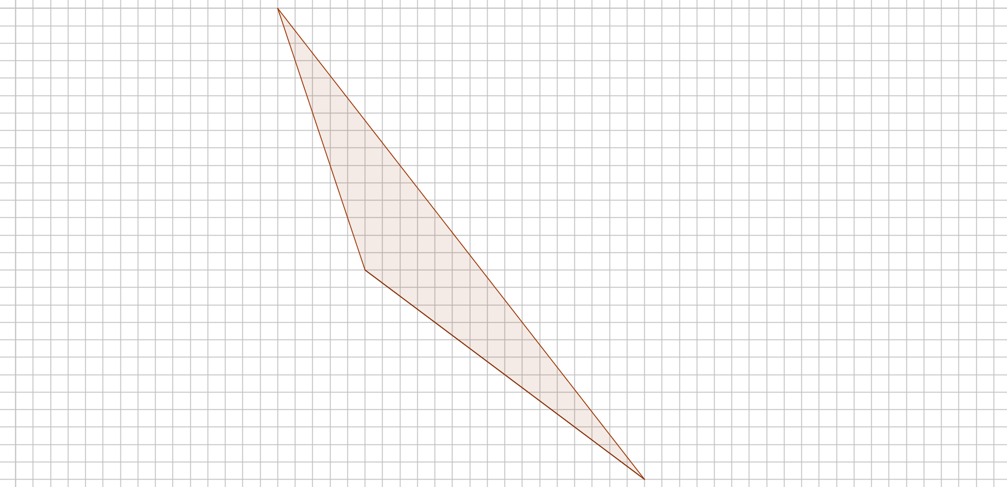
Sloping Triangle
What’s the area of this triangle?
(Each square represents 1 cm²)
K
SIC_56

Slide 23
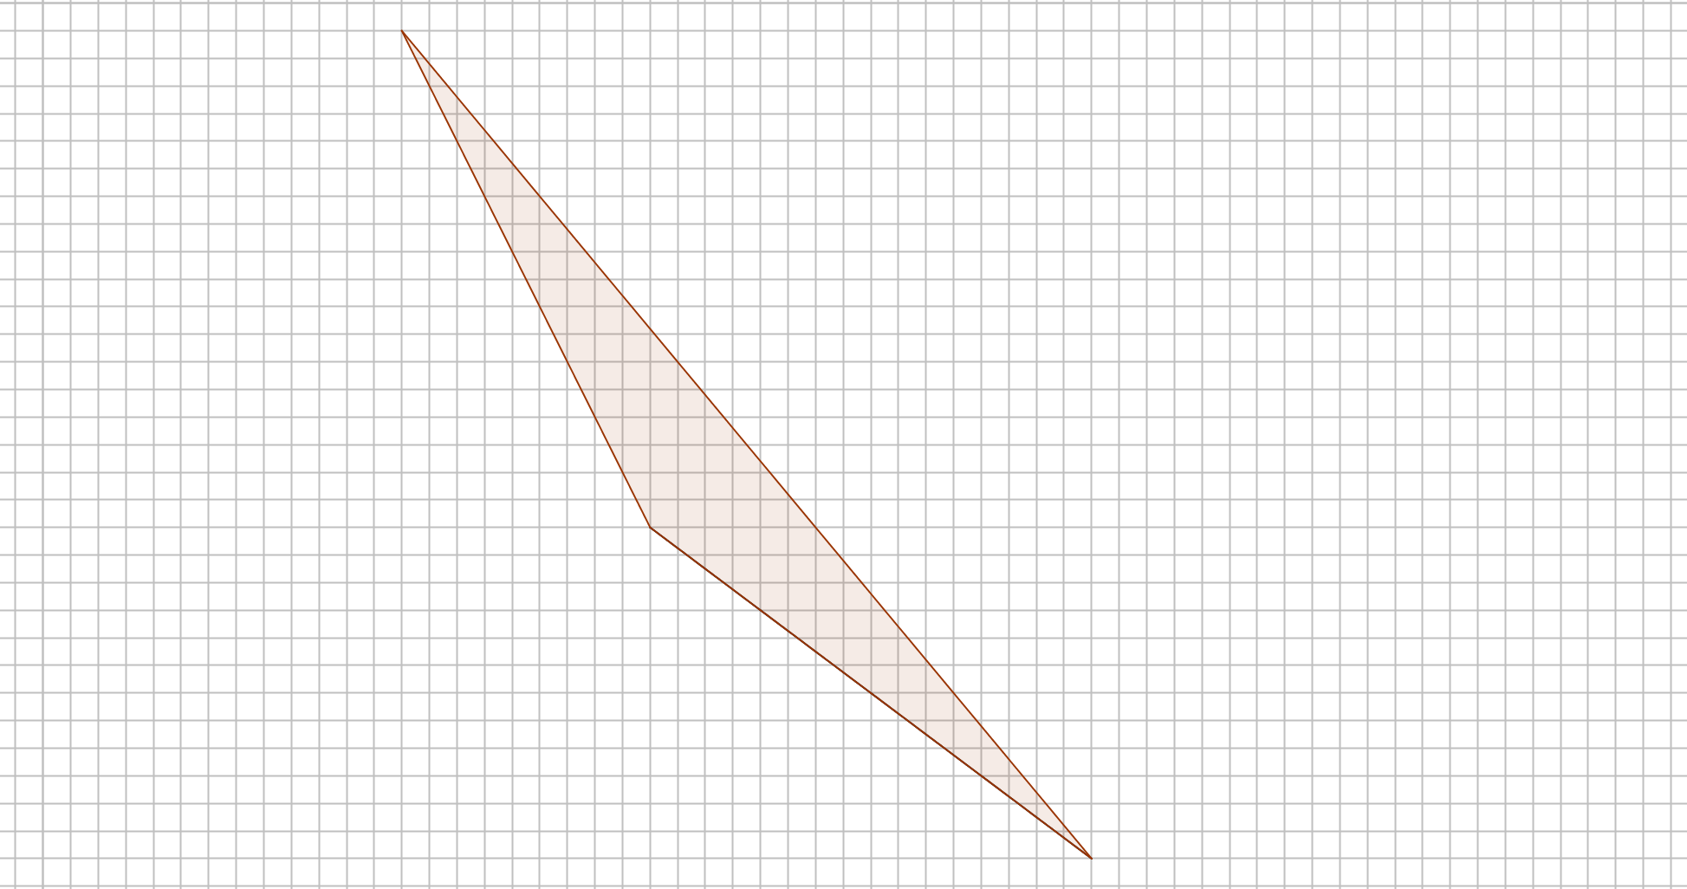
Sloping Triangle
What’s the area of this triangle?
(Each square represents 1 cm²)
L
SIC_56

